Slide 1


BMB5116 ARTIFICIAL INTELLIGENCE THEORY
INTELLIGENT AGENTS

Slide 2
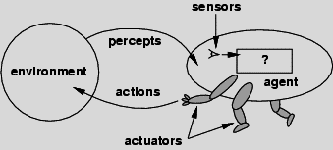
Agent
An agent is anything that can be viewed as
perceiving its environment through sensors and
acting upon that environment through actuators
Agent = program + architecture

Slide 3
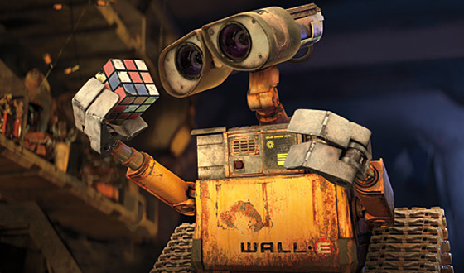
Agent Function
actions = AgentFunction(percepts)
sensors
AgentFunction
actuators
3

Slide 4
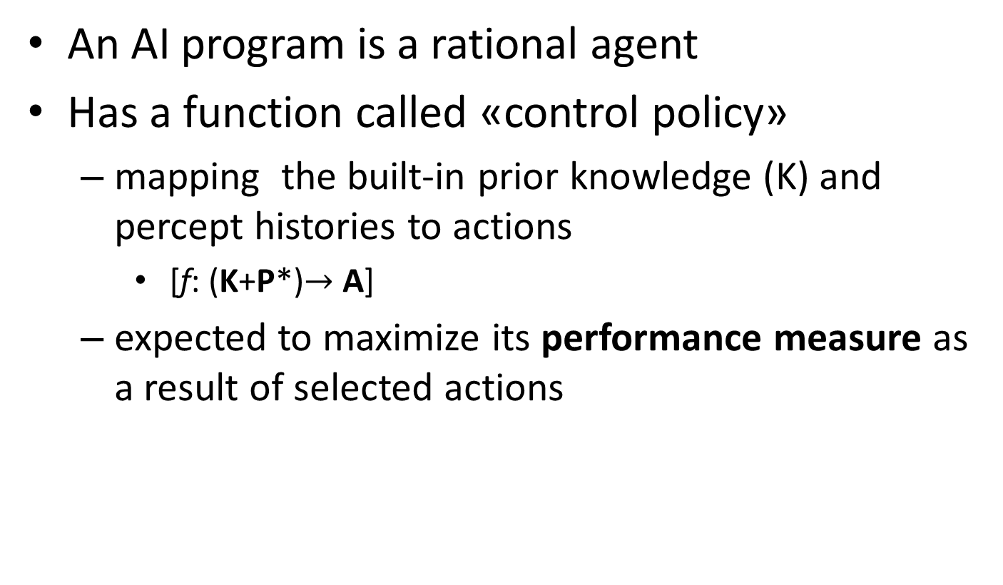
Rational Agent
An AI program is a rational agent
Has a function called «control policy»
mapping the built-in prior knowledge (K) and percept histories to actions
[f: (K+P*)$→$ A]
expected to maximize its performance measure as a result of selected actions
Notes:
For each possible percept sequence, a rational agent should select an action that is expected to maximize its
performance measure, given the evidence provided by the percept sequence and whatever built-in knowledge the agent has.

Slide 5
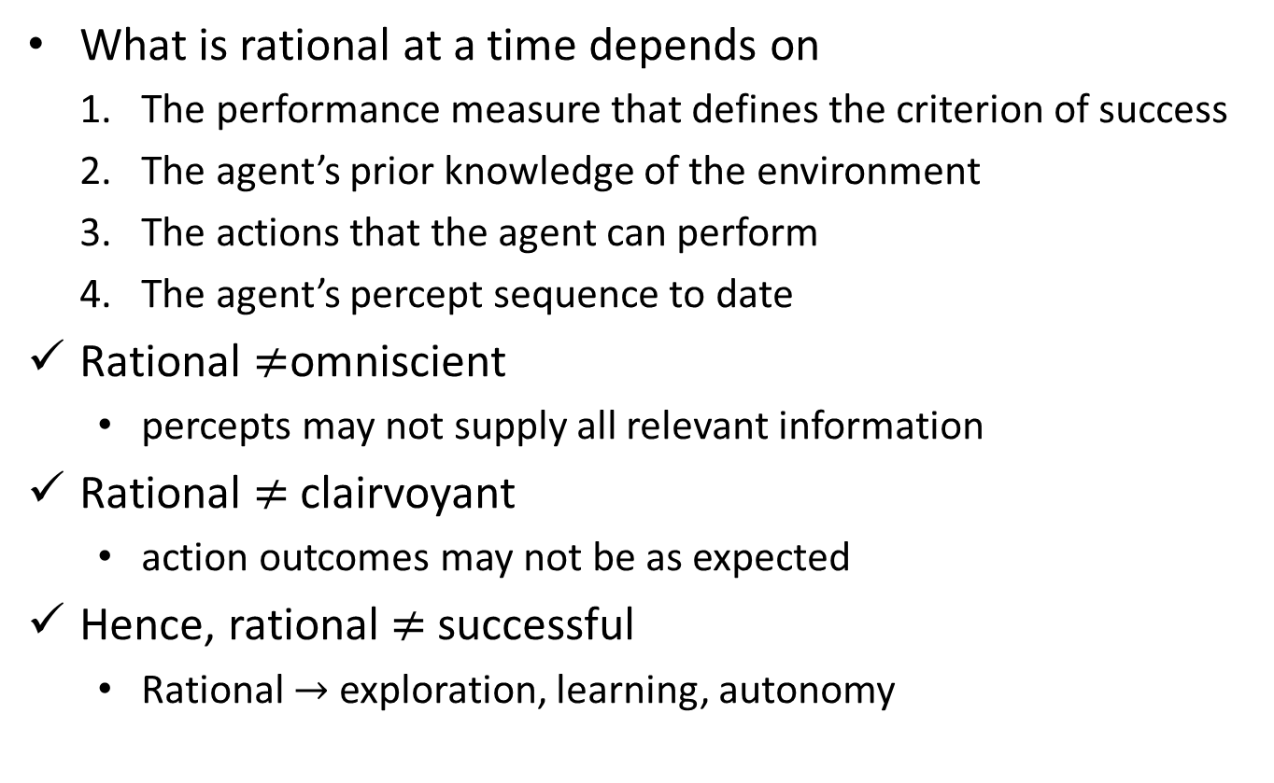
Rational Agent
What is rational at a time depends on
The performance measure that defines the criterion of success
The agent’s prior knowledge of the environment
The actions that the agent can perform
The agent’s percept sequence to date
Rational $≠$omniscient
percepts may not supply all relevant information
Rational $≠$clairvoyant
action outcomes may not be as expected
Hence, rational $≠$successful
Rational $→$ exploration, learning, autonomy

Slide 6
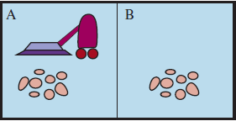
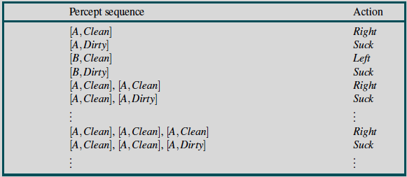
Vacuum Cleaner World
Two locations: A and B
• Percepts: location and contents,
e.g., [A,Dirty]
• Actions: Left, Right, Suck, NoOp
Notes:
Percepts: location and contents, e.g., [A;Dirty]
Actions: Left, Right, Suck, NoOp

Slide 7
PEAS
the setting for an intelligent agent design
Performance measure
Environment
Actuators
Sensors

Slide 8
Automated Taxi Driving Agent
Performance Measure:
Maintain safety, reach destination, maximize profits (fuel, tire wear), obey laws, provide passenger comfort, …
Environment:
urban streets, freeways, traffic, pedestrians, weather, customers, …
Actions:
Steer, accelerate, brake, horn, speaker, display, …
Sensors:
Video, sonar, speedometer, odometer, engine sensors, keyboard input, microphone, GPS, …

Slide 9
Interactive English Tutor Agent
Performance measure:
Maximize students' score on test
Environment:
Set of students
Actuators:
Screen display, speaker
exercises, suggestions, corrections
Sensors:
Keyboard, mouse, microphone

Slide 10
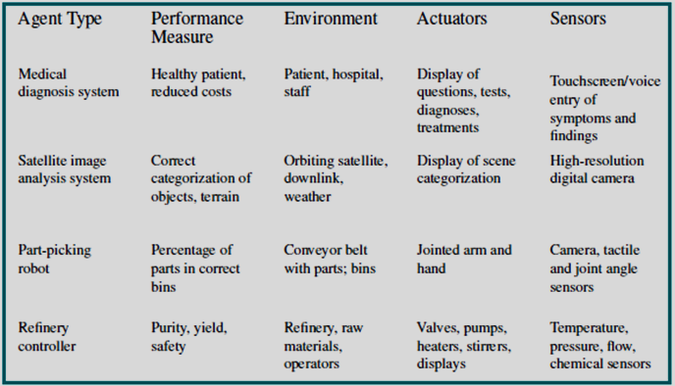
PEAS: Examples

Slide 11
Agent Characteristics
Situatedness
receives some sensory input from its environment
performs some action that changes its environment in some way.
Autonomy
acts without direct intervention by humans or other agents
has control over its own actions and internal state.
Adaptivity
reacts flexibly to changes in its environment;
takes goal-directed initiative, when appropriate;
learns from its own experience, environment, and interactions;
performs actions in order to modify future percepts so as to obtain useful information (information gathering, exploration)
Sociability
interacts in a peer-to-peer manner with other agents or humans.

Slide 12
Environment Types (I)
Fully observable vs. Partially observable
if an agent's sensors have access to the complete state of the environment at each point in time.
vacuum cleaner with local dirt sensor→partially observable
Deterministic vs. Stochastic
if the next state of the environment is completely determined by the current state and the action executed by the agent
Taxi driving or games with dice→stochastic
If the environment is deterministic except for the actions of other agents, then the environment is strategic (chess)
Episodic vs. Sequential
if the states are independent of or dependent on each other
Episode: single cycle of an agent perceiving and taking an action
Episodic: choice of action in an episode depends on episode itself
classification tasks
Sequential: current decision affects future decisions
chess
Notes:
Fully observable vs. Partially observable
An environment is fully observable if an agent's sensors have access to the complete state of the environment at each point in time.
Fully observable environments are convenient, because the agent need not maintain any internal state to keep track of the world
An environment might be partially observable because of noisy and inaccurate sensors or because parts of the state are simply missing from the sensor data
Examples: vacuum cleaner with local dirt sensor, taxi driver
Deterministic vs. Stochastic
The environment is deterministic if the next state of the environment is completely determined by the current state and the action executed by the agent.
In principle, an agent need not worry about uncertainty in a fully observable, deterministic environment
If the environment is partially observable then it could appear to be stochastic
Examples: Vacuum world is deterministic while taxi driver is not
If the environment is deterministic except for the actions of other agents, then the environment is strategic
Deterministic environment:
– Each action has a guaranteed effect
– An agent can determine the state of the world
by knowing the state before an action
happens and knowing the effect of the action
– Physical world: Deterministic?
Episodic vs. Sequential
In episodic environments, the agent's experience is divided into atomic "episodes" (each episode consists of the agent perceiving and then performing a single action), and the choice of action in each episode depends only on the episode itself.
Examples: classification tasks
In sequential environments, the current decision could affect all future decisions
Examples: chess and taxi driver
History freedom:
– Episode: Single cycle of an agent perceiving
and taking an action
– Episodic: If the choice depends on the current
episode and not on previous episodes
• Easier to operate
– Sequential: History matters
• Needs thinking ahead
• Chess

Slide 13
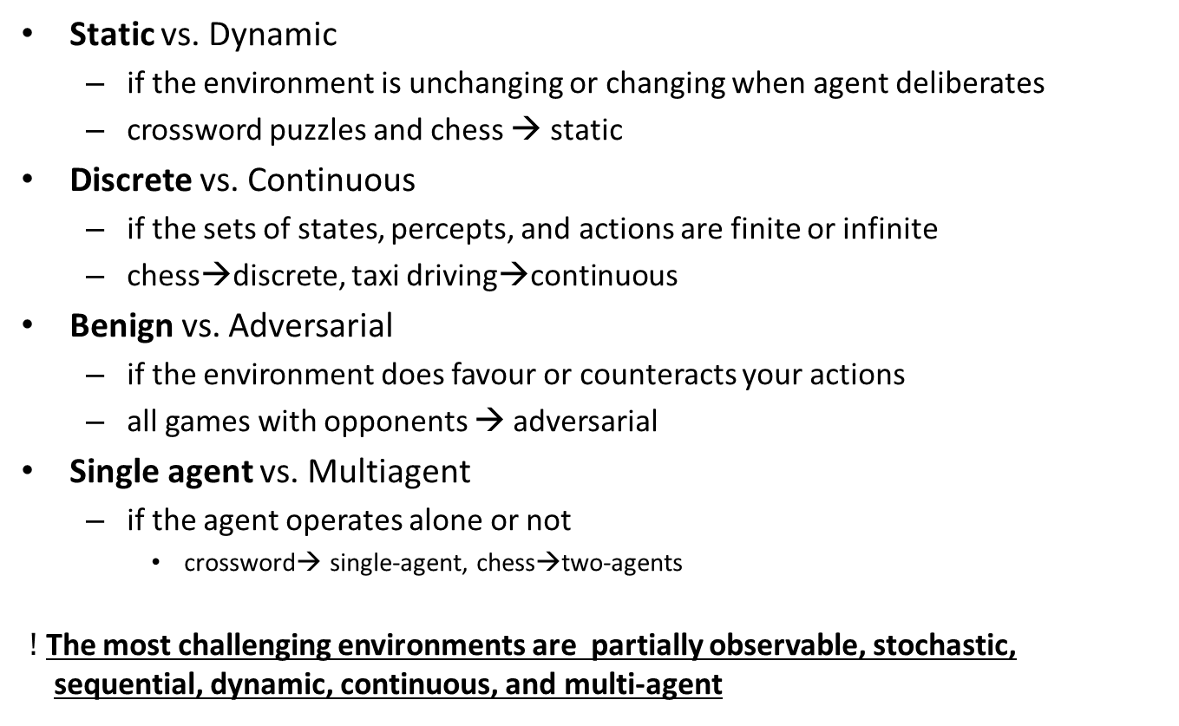
Environment Types (II)
Static vs. Dynamic
if the environment is unchanging or changing when agent deliberates
crossword puzzles and chess → static
Discrete vs. Continuous
if the sets of states, percepts, and actions are finite or infinite
chess→discrete, taxi driving→continuous
Benign vs. Adversarial
if the environment does favour or counteracts your actions
all games with opponents → adversarial
Single agent vs. Multiagent
if the agent operates alone or not
crossword→ single-agent, chess→two-agents
$!$ The most challenging environments are partially observable, stochastic, sequential, dynamic, continuous, and multi-agent
Notes:
Static vs. Dynamic
The environment is unchanged while an agent is deliberating.
Static environments are easy to deal with because the agent need not keep looking at the world while it is deciding on the action or need it worry about the passage of time
Dynamic environments continuously ask the agent what it wants to do
The environment is semi-dynamic if the environment itself does not change with the passage of time but the agent's performance score does
Examples: taxi driving is dynamic, chess when played with a clock is semi-dynamic, are static
Static environment:
– The environment only changes by the actions of the agent
– Ex: Chess
• Dynamic environment:
– Other agents’ actions can change the environment
– The environment itself can change over time
– Ex: Internet
Discrete vs. Continuous
A limited number of distinct, clearly defined states, percepts and actions.
Examples: Chess has finite number of discrete states, and has discrete set of percepts and actions. Taxi driving has continuous states, and actions
Discrete environment:
– Fixed, finite number of actions and percepts
– Chess: At each time point, the number of actions is finite
• Continuous environment:
– Not composed of discrete units
– Either number of actions or percepts infinite
• Possible to convert continuous
environments into discrete environments
(with loss of precision)
Single agent vs. Multiagent
An agent operating by itself in an environment is single agent
Examples: Crossword is a single agent while chess is two-agents
Question: Does an agent A have to treat an object B as an agent or can it be treated as a stochastically behaving object
Whether B's behaviour is best described by as maximizing a performance measure whose value depends on agent's A behaviour
Examples: chess is a competitive multiagent environment while taxi driving is a partially cooperative multiagent environment
Single vs. Multiagent
• Open environment:
–Autonomous entities
• Can enter and leave frequently
• Don’t need to let anyone know
• No control over what others will do
–Cooperative entities
• No use of sellers if they cannot cooperate with customers
• Need for rules, regulations, contracts

Slide 14
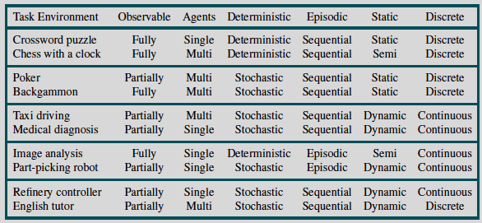
Environment Types: Examples

Slide 15
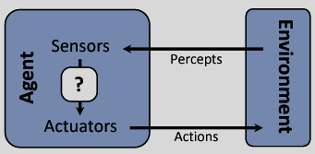
Agent Types
Simple reflex agents
Model-based reflex agents
Simple reflex agents with state
Goal-based agents
Utility-based agents
Learning agents
Notes:
All can be turned into learning agents

Slide 16
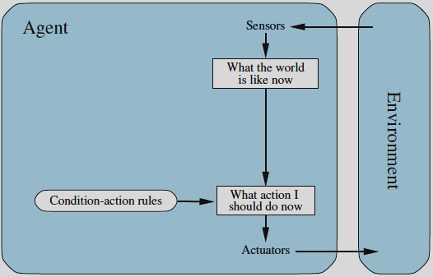
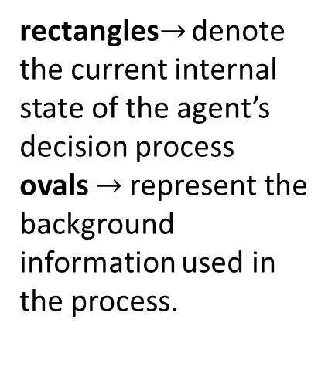
Simple Reflex Agents
Acts according to a rule whose condition matches the current state, as defined by the percept.
rectangles$→$ denote the current internal state of the agent’s decision process
ovals $→$represent the background information used in the process.
Notes:
A simple reflex agent acts according to a rule whose condition matches the current state, as defined by the percept.
Select actions based only on the current percept, ignoring the rest of the percept history.
• Table lookup of percept-action pairs defining all possible condition-action rules necessary to interact in an environment

Slide 17
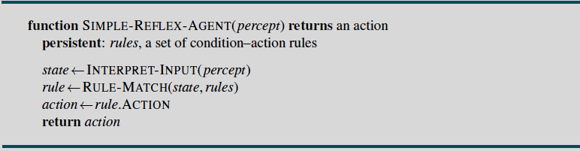
Simple Reflex Agents
Problems
Possible condition-action rules too big to generate and store
e.g. chess has about 10120 states
No knowledge of non-perceptual parts of the current state
Not adaptive to changes in the environment
requires entire table to be updated if changes occur

Slide 18
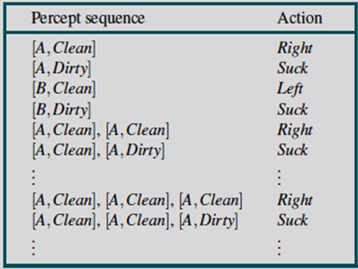
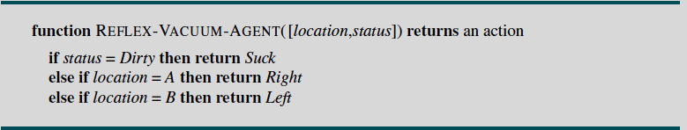
Vacuum Cleaner World
Percepts: location and contents,
e.g., [A; Dirty]
Actions: Left, Right, Suck, NoOp
Simple Reflex agent program in the two state vacuum environment

Slide 19
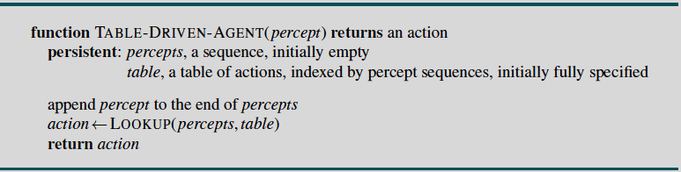
Table-Driven Agent
Drawbacks:
Huge table
Take a long time to build the table
No autonomy
Even with learning, need a long time to learn the table entries

Slide 20
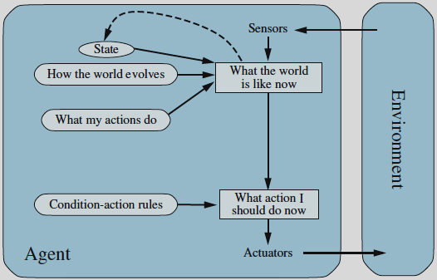
Model-Based Reflex Agents
Encode "internal state" of the world to remember the past
Has the knowledge about “how the world evolves”
called a model of the world
Notes:
A model based reflex agent keeps track of the current state of the world using an internal model. It then chooses an action in the same way as the reflex agent.
Reflex Agent with State = model-based agent
• The knowledge about “how the world works” is called a model of the world.
• An agent that uses such a model is called a model-based agent.
• Encode "internal state" of the world to remember the past as contained in earlier percepts
• Needed because sensors do not usually give the entire state of the world at each input, so perception of the environment is captured over time. "State" used to encode different "world states" that generate the same immediate percept.
• Requires ability to represent change in the world; one possibility is to represent just the latest state, but then can't reason about hypothetical courses of action

Slide 21
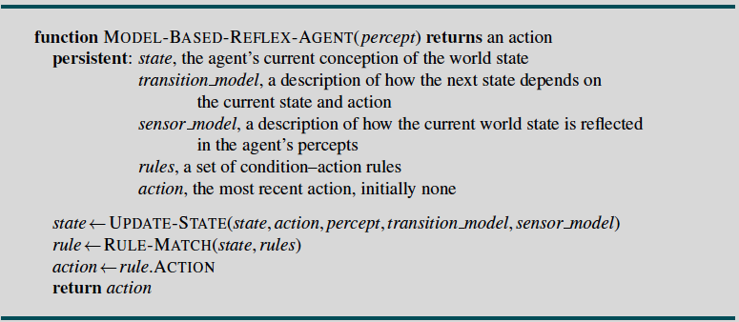
Model-Based Reflex Agents
Notes:
A model based reflex agent keeps track of the current state of the world using an internal model. It then chooses an action in the same way as the reflex agent.
Reflex Agent with State = model-based agent
• The knowledge about “how the world works” is called a model of the world.
• An agent that uses such a model is called a model-based agent.
• Encode "internal state" of the world to remember the past as contained in earlier percepts
• Needed because sensors do not usually give the entire state of the world at each input, so perception of the environment is captured over time. "State" used to encode different "world states" that generate the same immediate percept.
• Requires ability to represent change in the world; one possibility is to represent just the latest state, but then can't reason about hypothetical courses of action

Slide 22
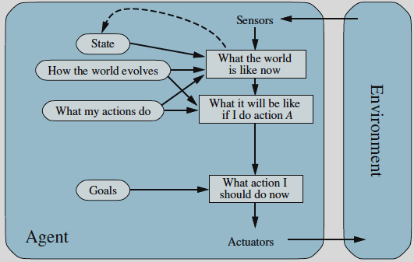
Goal-Based Agents
Plan or search a sequence of actions such that applying those actions will transform the current state into the goal state
Deliberative instead of reactive
Notes:
It keeps track of the world state as well as
a set of goals it is trying to achieve, and chooses an action that will (eventually) lead to the
achievement of its goals.
Add a goal
– What is the agent trying to do?
– Drive to Taksim; buy a book online
– Perform actions that will realize the goal
• A set of condition-action rules is not enough
• Think about a goal state where the desired goal holds
• Plan or search a sequence of actions such that applying those actions will transform the current
state into the goal state
Choose actions so as to achieve a (given or computed) goal= a description of a desirable situation
• Keeping track of the current state is often not enough--- need to add goals to decide which situations are good
• May have to consider long sequences of possible actions before deciding if goal is achieved--- involves consideration of the
future, "what will happen if I do...?"

Slide 23
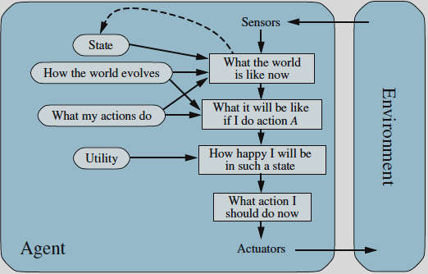
Utility-Based Agents
From a number of goals choose the one with best utility
Utility is a function from states to real numbers.
eg. quantitative measure of a chosen path
Notes:
Utility-Based Agents (1)
• A goal-oriented agent may achieve its goals in a number of ways.
• Nothing is said about whether one way is better than another
• However, one path can be preferred over another because it’s shorter, cheaper, etc.
• Agents may have conflicting goals*
– Buy a book with a low cost and buy it fast
–Which goal should have precedence over the other?
• Assign a utility to each goal
• Maximize expected utility

Slide 24
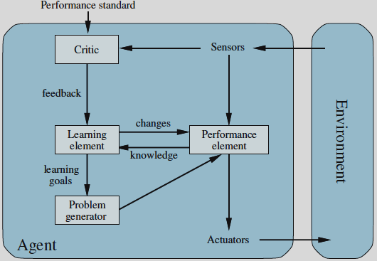
Learning Agents
Has a learning element that is responsible for making improvements.
Performance element is the entire agent.
can be a simple-reflex, model-based or utility-based agent
Notes:
The “performance element” box represents what we
have previously considered to be the whole agent program. Now, the “learning element” box
gets to modify that program to improve its performance.
Components of a Learning Agent
• learning element, which is responsible for making improvements,
• performance element, which is responsible for selecting external actions. The performance element is the entire agent: it takes in percepts and decides on actions.
• critic gives feedback from the on how the agent is doing.
• problem generator is responsible for suggesting actions that will lead to new and informative experiences.

Slide 25
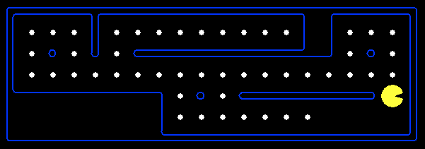
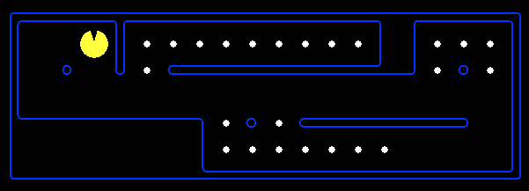
Reflex Agents
Reflex agents:
Choose action based on current state
May have memory or a model of the world’s current state; use percept
Do not consider the future consequences of their actions
Act on how the world is
Can a reflex agent be rational (optimal)?
Strategy: Dots: WNES
No Dots: NESW

Slide 26
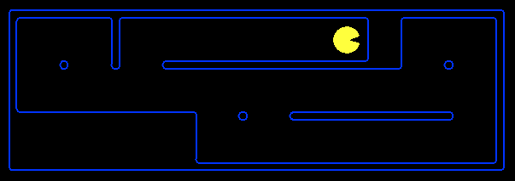
Goal Based Agents
Goal-based agents:
Plan ahead
Ask “what if”
Decisions based on (hypothesized) consequences of actions
Must have a model of how the world evolves in response to actions
Act on how the world would be

Slide 27
Agent Architectures
Reactive architectures
Simple reflex
Model-based reflex
Deliberative architectures
Goal-based
Utility-based
Hybrid architectures
Combines both reactive and deliberative architectures
Is learning-based agent architecture a reactive or deliberative architecture?

Slide 28
Agents Development
Depends on what is expected of the agent
A learning agent with full access to deep and machine learning libraries
Python: scikit, scipy, pandas, opencv, numpy, tensorflow, keras, pytorch
Matlab: core Matlab, DL, ML, CV, IP, FL toolboxes and libraries
An agent that interacts with other agents over the Web
JAVA-based Jadex (Java Agent DEvelopment Framework)
Better support for Web standards
Easy integration with other programming environments
Python
An agent that processes logical or functional formulae
Prolog, Java+Prolog, Lisp
C++ remains as an option
dlib, openCV, openGL, cuda libraries …
Notes:
Agent0, GOLOG, 3APL
Agent programming languages
Constructs for beliefs, goals, etc.
Specify rules to reason on these (update, delete)
Use an interpreter which will track which rules are fired and make modifications accordingly
Java Agent DEvelopment Framework (JADE)
FIPA-compliant
Available libraries for agent templates
MadKit
Agents programmed in Java
Enforce an organization model so that each agent plays a role in the MAS
OAA, JATLite, IBM Able

Slide 29
Summary
An agent perceives and acts in an environment, has an architecture, and is implemented by an agent program.
An intelligent agent always chooses the action which maximizes its expected performance, given its percept sequence so far.
An autonomous agent uses its own experience rather than built-in knowledge of the environment by the designer.
An agent program maps from percept to action and updates its internal state.
Reflex agents respond immediately to percepts.
Goal-based agents act in order to achieve their goal(s).
Utility-based agents maximize their own utility function.
Representing knowledge is important for successful agent design.
PEAS descriptions define task environments.
Environments are categorized along several dimensions:
fully observable? deterministic? episodic? static? discrete? single-agent?
Notes:
Summary
Agents interact with environments through actuators and sensors
The agent function describes what the agent does in all circumstances
The performance measure evaluates the environment sequence
A perfectly rational agent maximizes expected performance
Agent programs implement (some) agent functions

